Slide 1
Animation with angular
https://stackblitz.com/edit/aur-ng-animation-brownbag
Just enough to get going

Slide 2
Ways to animate
CSS3 Animations
@angular/animations
Built in with CSS3
Keyframes
Duration
Easing/Timing function
Built on top of Web Animations abstraction
Cleaner API, more readable code
Automatic property calculation
Transitions, query, style, animate, complex animations
More controls like callbacks
Web Animations API
Browser support
Complex easing functions
animate()
Notes:
Web animations support more complex animations, timing functions for different parts of the animations and provides programmability support.

Slide 3
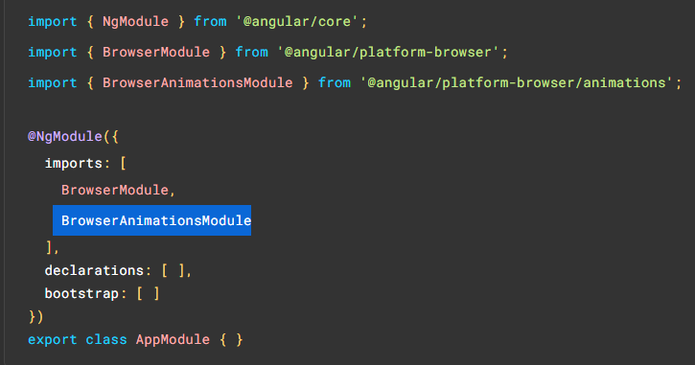
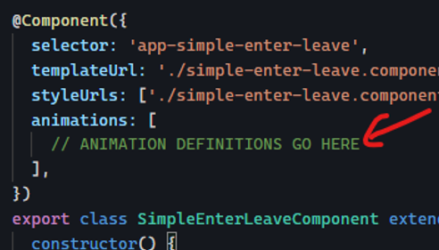
Setting up for animations
@import BrowserAnimationsModule
Add animations metadata
* NoopAnimationsModule // for unit test

Slide 4
Key concepts
trigger
states
Transition & ANimation
Element to animate @elementToAnimate
Void (void)
Default (*)
Custom
stateA => stateB
:enter/:leave
style()
animate()
Duration & Easing (timing function)

Slide 5
Dissecting a simple animation code
trigger()
Targets element
transition()
What to do when a specific state change occurs
style()
Define the a CSS style for a state
animate()
Defines an animation consisting of timing and style()
animations: [
trigger('targetRectangle', [
transition(':enter', [
style({ opacity: 0, transform: 'scale(0.6)' }),
animate('300ms ease-out', style({ opacity: 1, transform: 'scale(1)' })),
]),
transition(':leave', [
animate(
'300ms ease-out',
style({ opacity: 0, transform: 'scale(0.6)' })
),
]),
]),
]
<div
class="target"
*ngIf="targetVisible"
@targetRectangle
(@targetRectangle.start)="onAnimationStarted()"
(@targetRectangle.done)="onAnimationDone()"
></div>

Slide 6
Let’s see some <code />
StackBlitz https://stackblitz.com/edit/aur-ng-animation-brownbag
GitHub https://github.com/ananthanunni/ng-animations
Hosted version https://aur-ng-animation-brownbag.stackblitz.io
⚠️ Warning: Graphic content ahead

Slide 7
Complex Animations
Staggered
grouped
animations: [
trigger('pageAnimations', [
transition(':enter', [
query('.hero', [
style({opacity: 0, transform: 'translateY(-100px)'}),
stagger(30, [
animate('500ms cubic-bezier(0.35, 0, 0.25, 1)',
style({ opacity: 1, transform: 'none' }))
]),
stagger('300ms',
animate('300ms', style({ marginRight: '-100%'}))
)
])
])
]),
]
animations: [
trigger('flyInOut', [
state('in', style({
width: '*',
transform: 'translateX(0)', opacity: 1
})),
transition(':enter', [
style({ width: 10, transform: 'translateX(50px)', opacity: 0 }),
group([
animate('0.3s 0.1s ease', style({
transform: 'translateX(0)',
width: '*'
})),
animate('0.3s ease', style({
opacity: 1
}))
])
]),
transition(':leave', [
group([
animate('0.3s ease', style({
transform: 'translateX(50px)',
width: 10
})),
animate('0.3s 0.2s ease', style({
opacity: 0
}))
])
])
])
]

Slide 8
That’s all I’ve got. Thank you!
Questions?

